Slide 1
Group 6:-Minimal Viable Product
By
Tyler Maregenetti s191857, Jack E. Massey s189328, Eva-Elena Bulai s195388, Marta Velartova s195845

Slide 2
Brief
What Genre are we using?
What Mechanic are we changing?
What are we changing the mechanic into?
What emotions are we looking for?
What are the Key Programming issues we will have?
What are the Key Design problems we will face?
Notes:
In the brief template we were give 6 question.

Slide 3
Our Game: Genre and Emotions
Platformer
Sympathy:- For the character
Shock:- For the harsh failure states (when the Main Character dies)
Relief/fiero?:- For completing a difficult level
Notes:
What Genre are we using?
What emotions are we looking for?

Slide 4
Our Gaming: Programming-wise
The player can control parts of the level, but not the main character
This involves the player moving parts of the level to allow the main character to move forward, which costs “mana”
Creating a level that the player is fully able to move around and modify will lead to some unforeseen challenges
Notes:
What Mechanic are we changing?
What are we changing the mechanic into?
What are the Key Programming issues we will have?

Slide 5

Gameplay
Notes:
https://www.youtube.com/watch?v=Nhyzc3oNFu0&feature=youtu.be

Slide 6
Meeting MVP: Programing
To reach a Minimum Viable Product, we still need to add:
Enemies / Other Hazards
Other abilities to help the player manipulate their environment
Level transitions
Potentially an inventory system for the player to place blocks

Slide 7
Our Game: Level Design-wise
By Eva-Elena Bulai

Slide 8
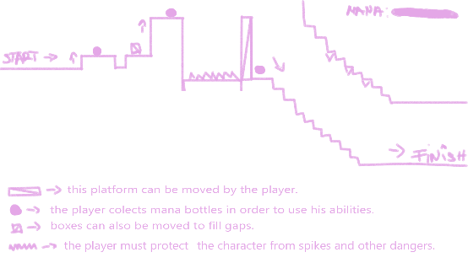
Level Design
The level design will be focused on gradual progression.
As the game progresses the challenge increases.

Slide 9
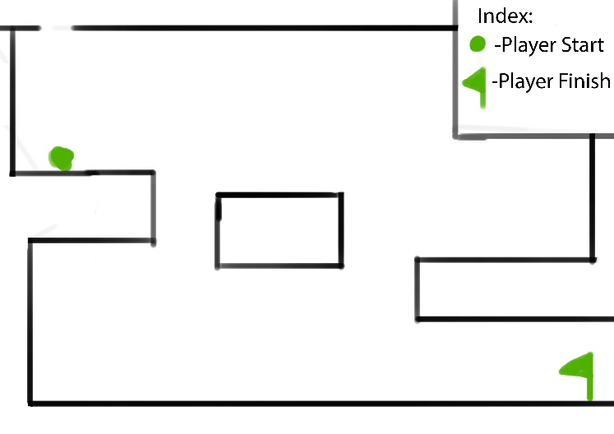
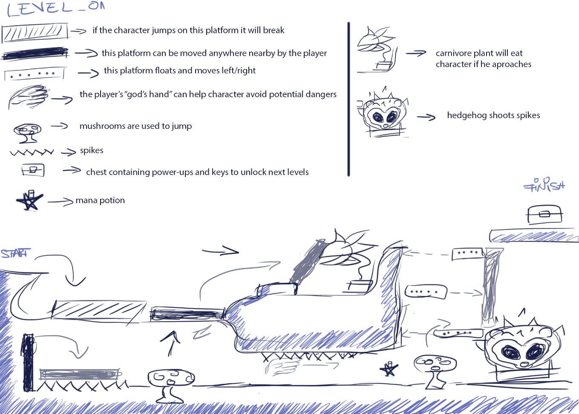
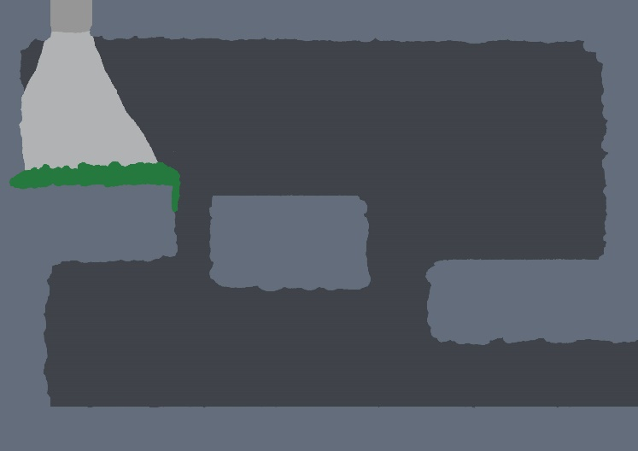
Other Level Design concepts
Level Concept by Eva
Level Concepts by Jack

Slide 10
Meeting MVP: Level Design
3 levels:
The Tutorial Level (learning the mechanics of the game)
A beginners styled level (to test the players learning)
A intermediate level (to challenge the player)

Slide 11
Our Game: Art
By Marta Velartova

Slide 12
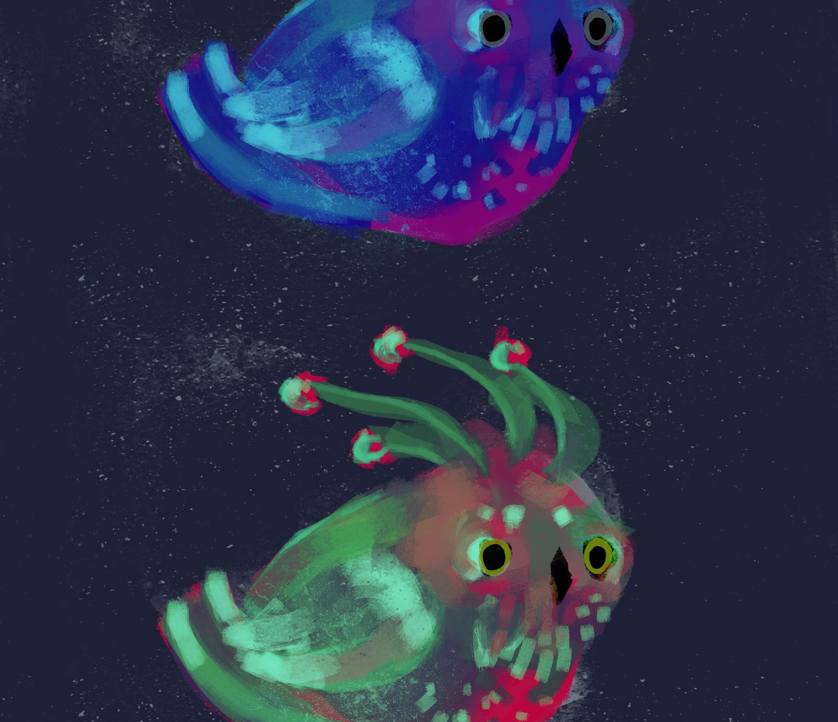
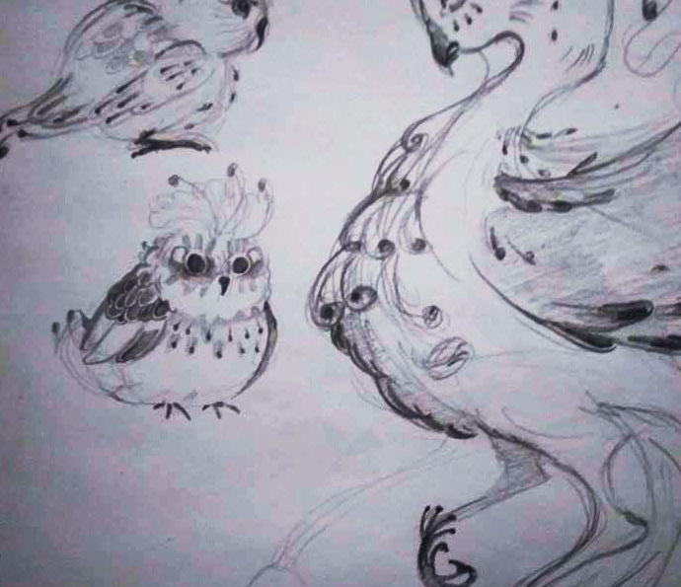
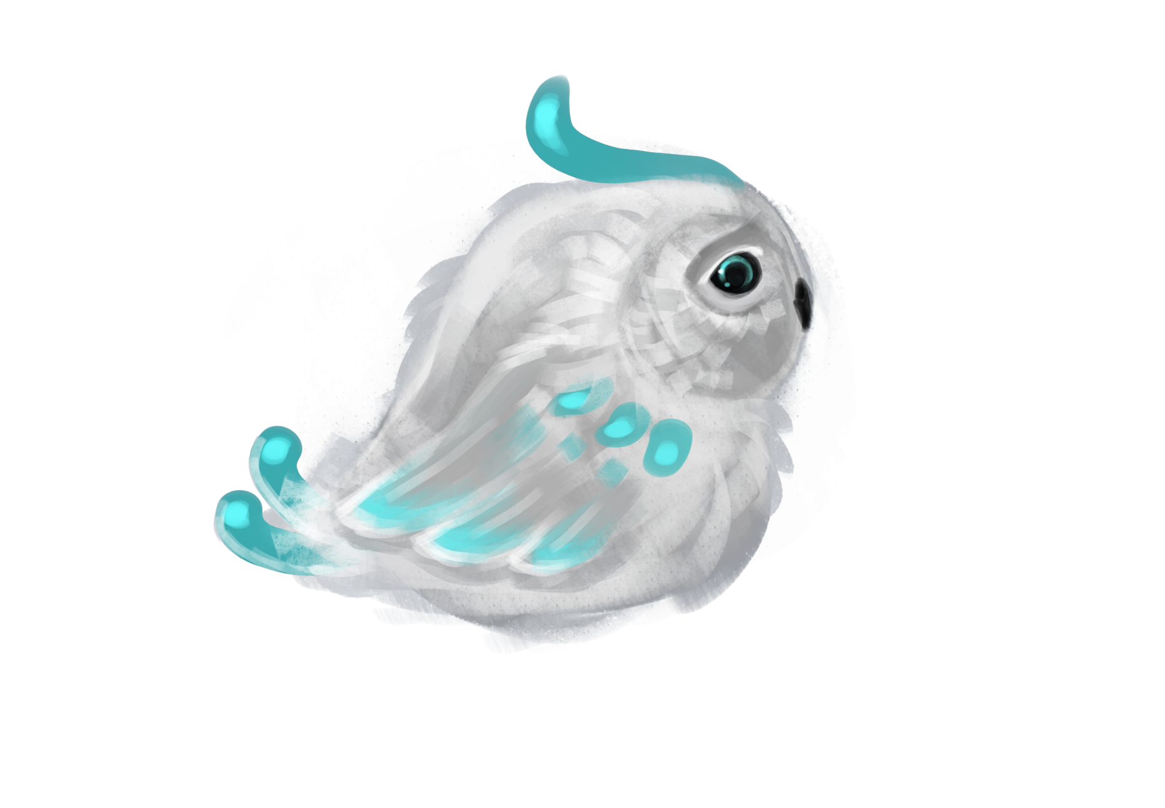
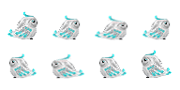
Art: Main Character
Little bird from magical world fell off his nest and is trying to get home
Must be cute, and magical looking
We want player to want to protect this character - small adorable animal, sad look
We want to create sympathy for the character

Slide 13


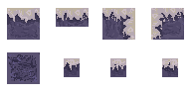
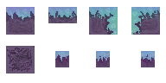
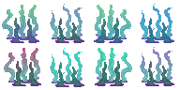
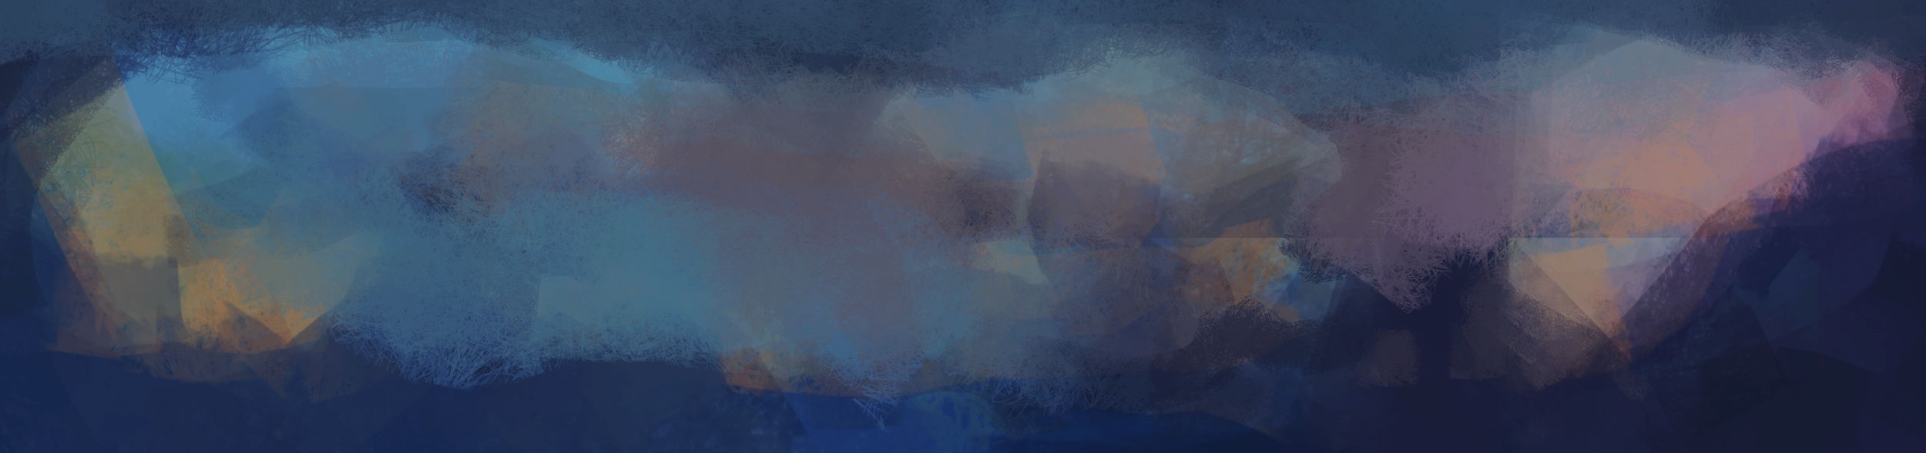
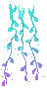
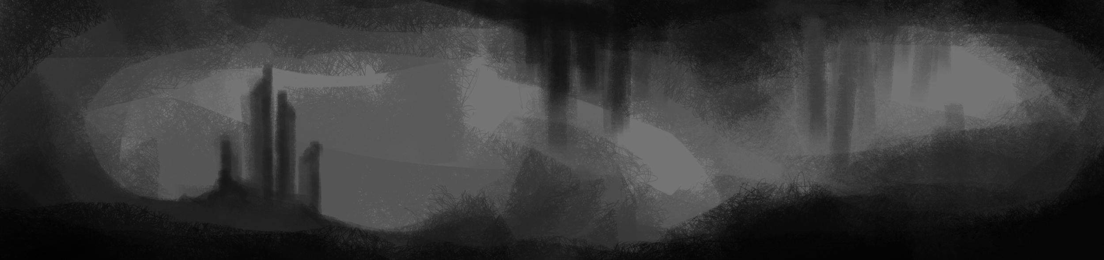
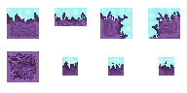
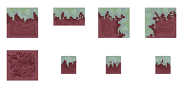

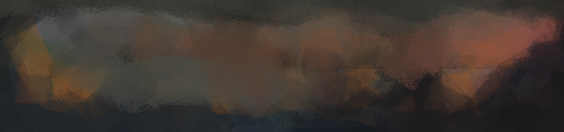
Art: assets
Character travels through different locations trying to find his way home – various locations - various assets
Starting from more dull levels (easy and not as colorful levels) and step by step is getting to the place where he belongs (colorful and more challenging levels)

Slide 14
Meeting MVP: Art
Finalised designs of:
The God hand (The mouse)
Mana potions
Dangers (Spikes, etc)

Slide 15


